Slide 1
An engineering company for designing houses and palaces in compounds

Slide 2
Contents
Section 1.
1.1 Project Description.............................................................................3
1.2 Project Life Cycle ................................................................................3
1.3 WBS ....................................................................................................4
1.4 Project Plan (Gantt chart)...................................................................5
Section 2.
2.1 context diagram ………………………….........................................................6
2.2 DFD …………………………………………….........................................................7
2.3 Use case diagram ………………………………………………………………………………8
2.4 Sequence diagram …………………………………………………………………………….9
2.5 Class diagram ………………………………………………………………………………….10
2.6 Activity diagram ……………………………………………………………………………….12,13
2.7 State diagram ……………………………………………………………………………….14,15
2.8 GUI ………………………………………………………………………..…………………….16,20
2.9 particial tool…………………………………………………………………………………21

Slide 3
1.1 Project Description
The main objective of this system : is to facilitate the various operations in the an engineering company for designing houses and palaces in compounds.
2.1 Project Life Cycle
The phases of the project:
1) System Planning
2) System Analysis
3) System Design
4) implement & coding

Slide 4
WBS

Slide 5
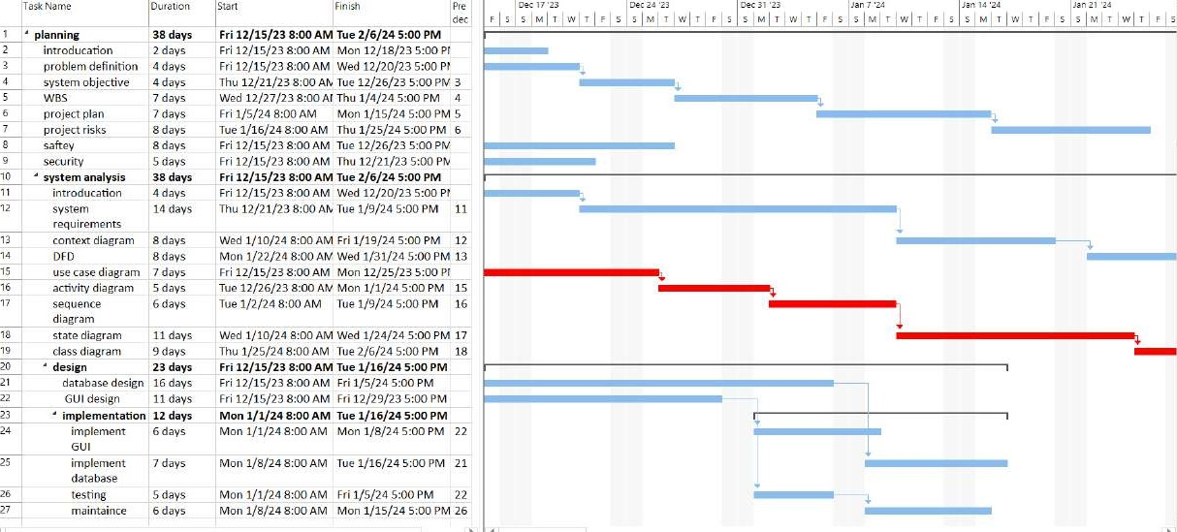
Project Plan (Gantt chart)

Slide 6
Context diagram

Slide 7
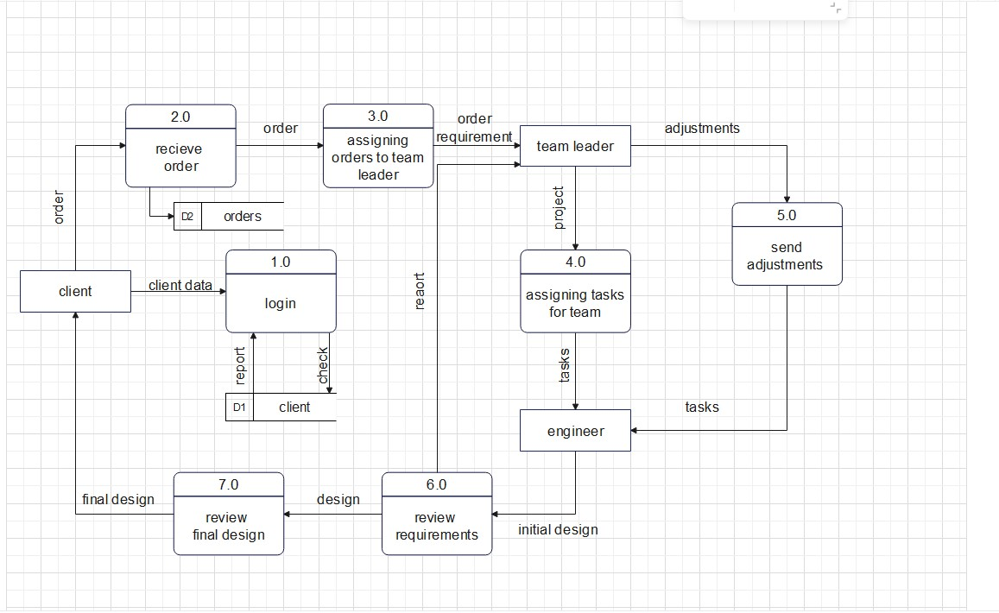
DFD

Slide 8
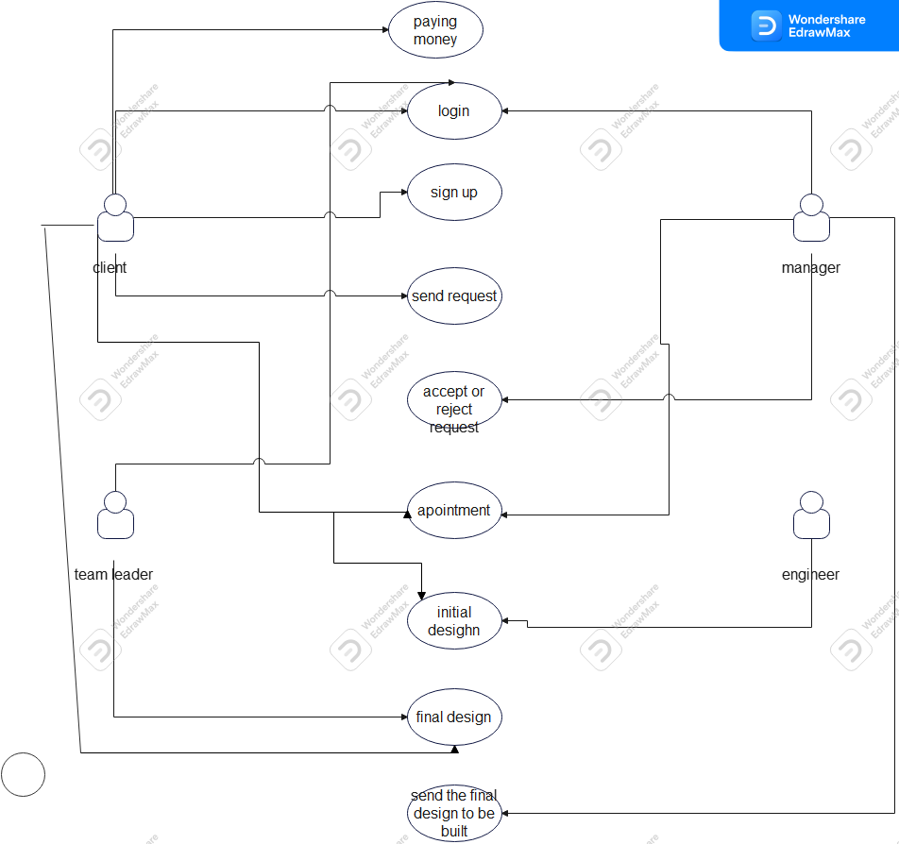
Use case diagram

Slide 9
Sequence diagram

Slide 10
Class diagram

Slide 11
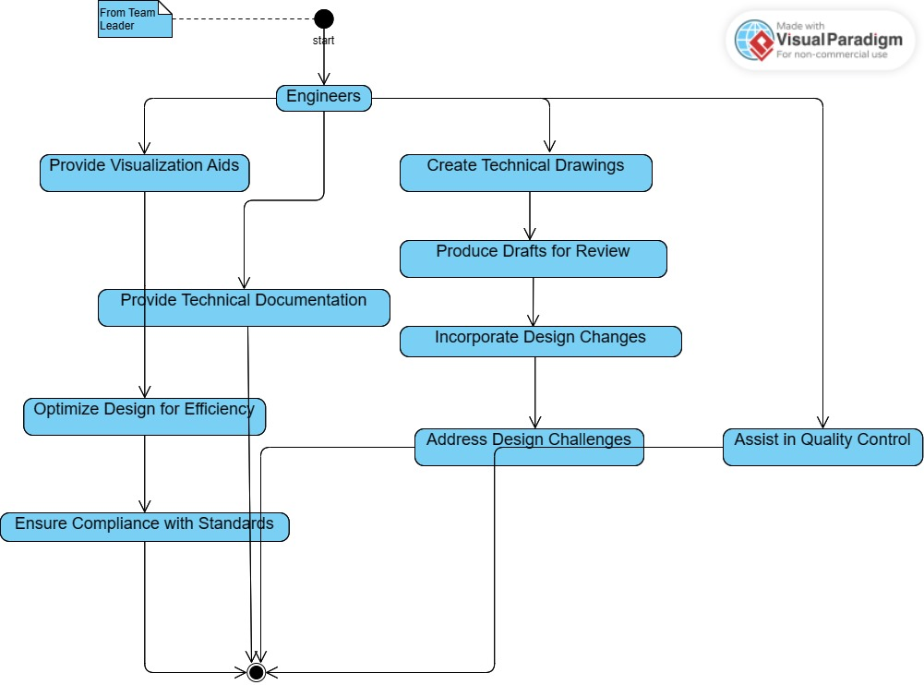
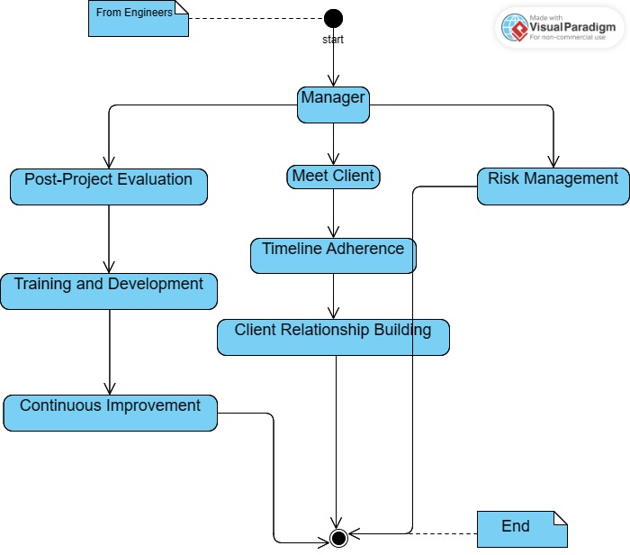
Activity diagram

Slide 12
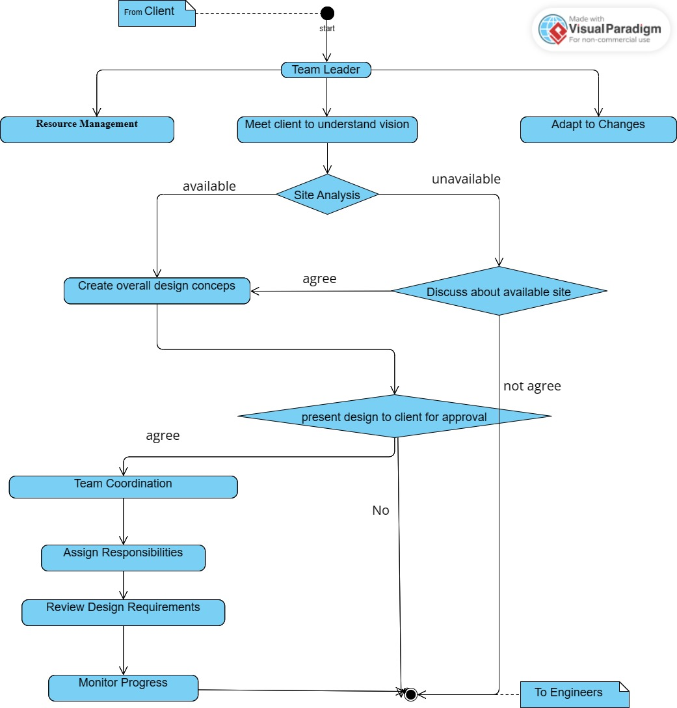
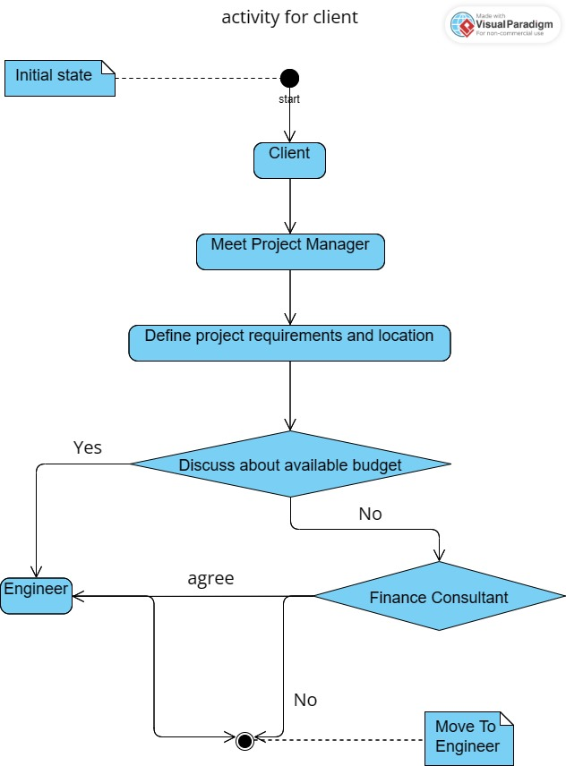
Activity diagram

Slide 13
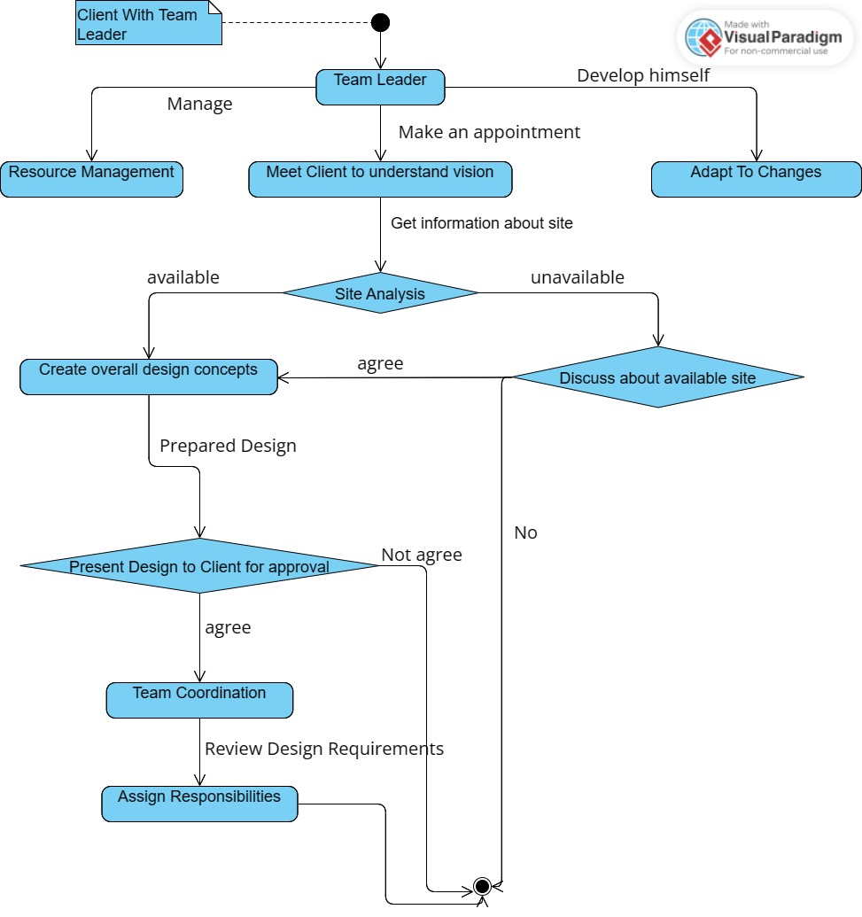
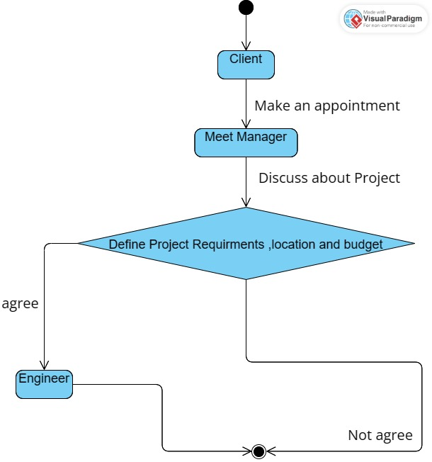
State diagram

Slide 14
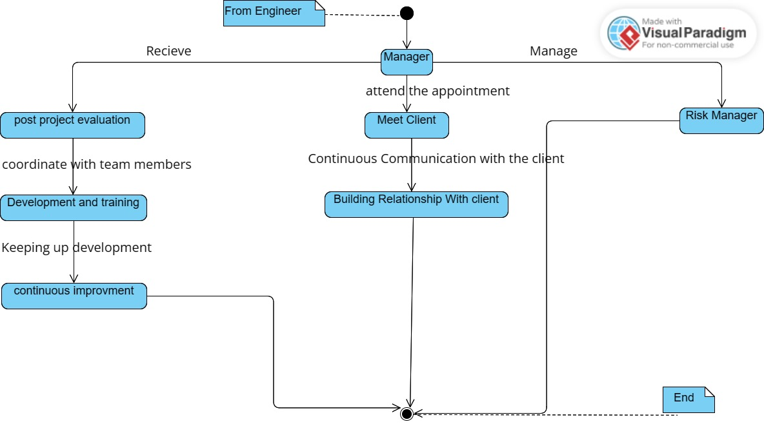
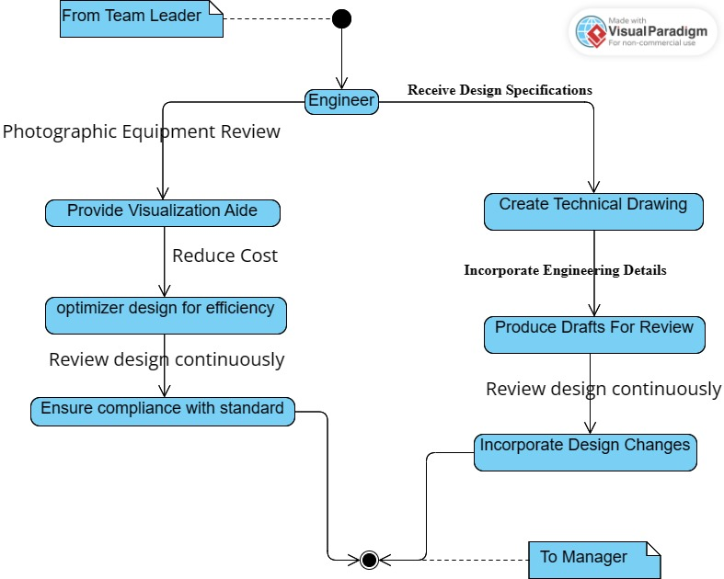
State diagram

Slide 15
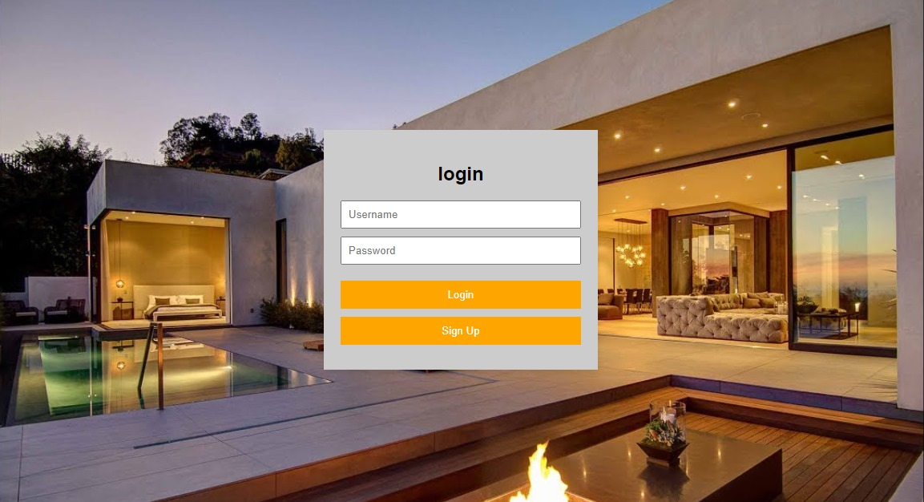
GUI
.

Slide 16
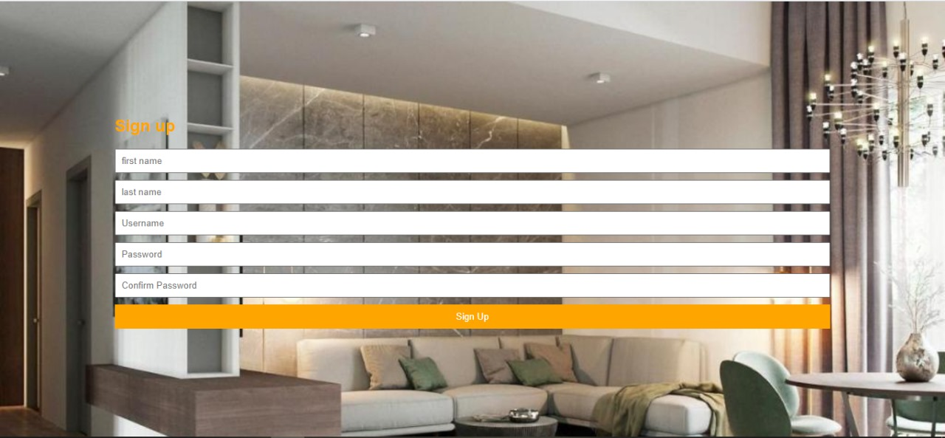
GUI

Slide 17
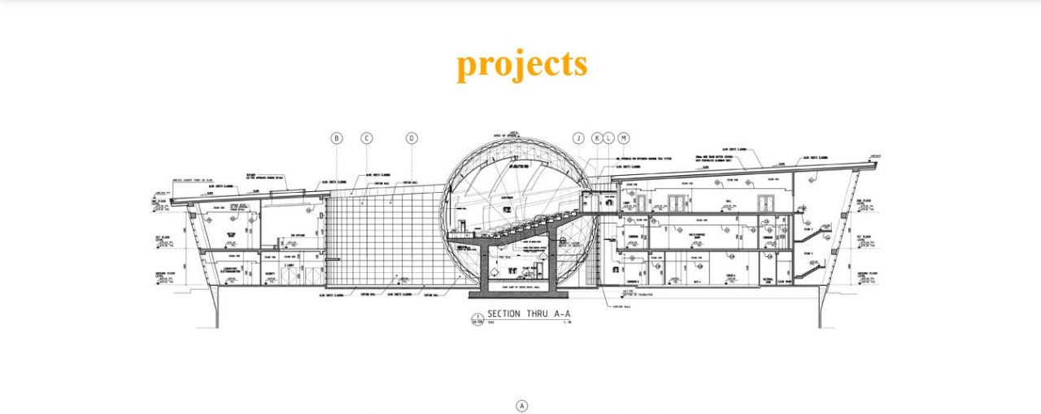
GUI

Slide 18
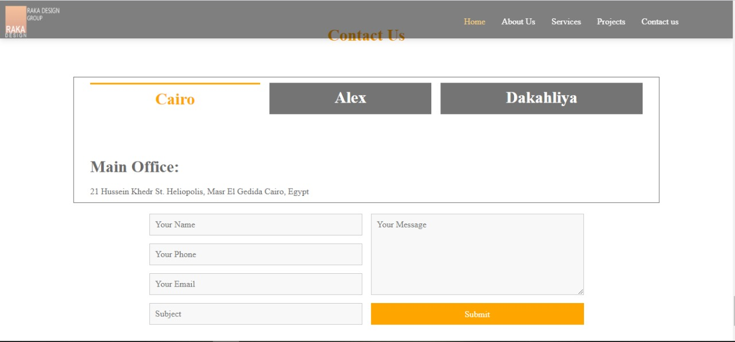
GUI

Slide 19
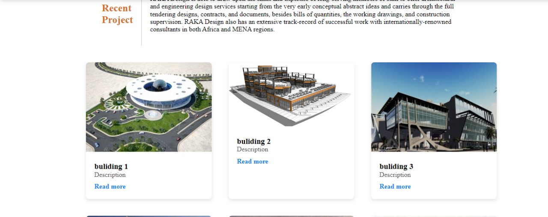
GUI

Slide 20
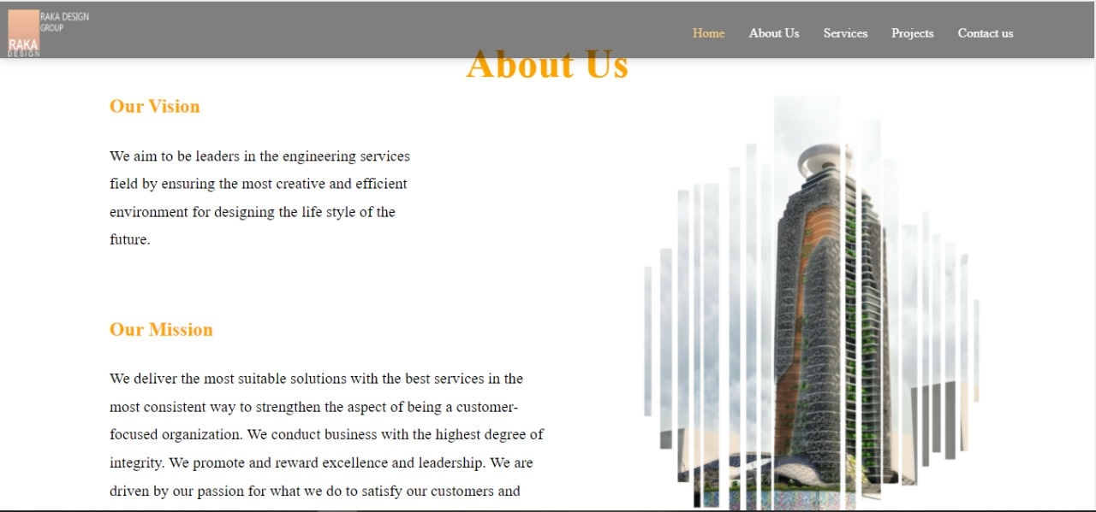
GUI

Slide 21
practical part
UML: context diagram, Use case, activity diagram, class diagram, sequence, state diagram → Fjma
Implement tools: vs code, SQL workbench
Project plan: Microsoft project managment

